Slide 1
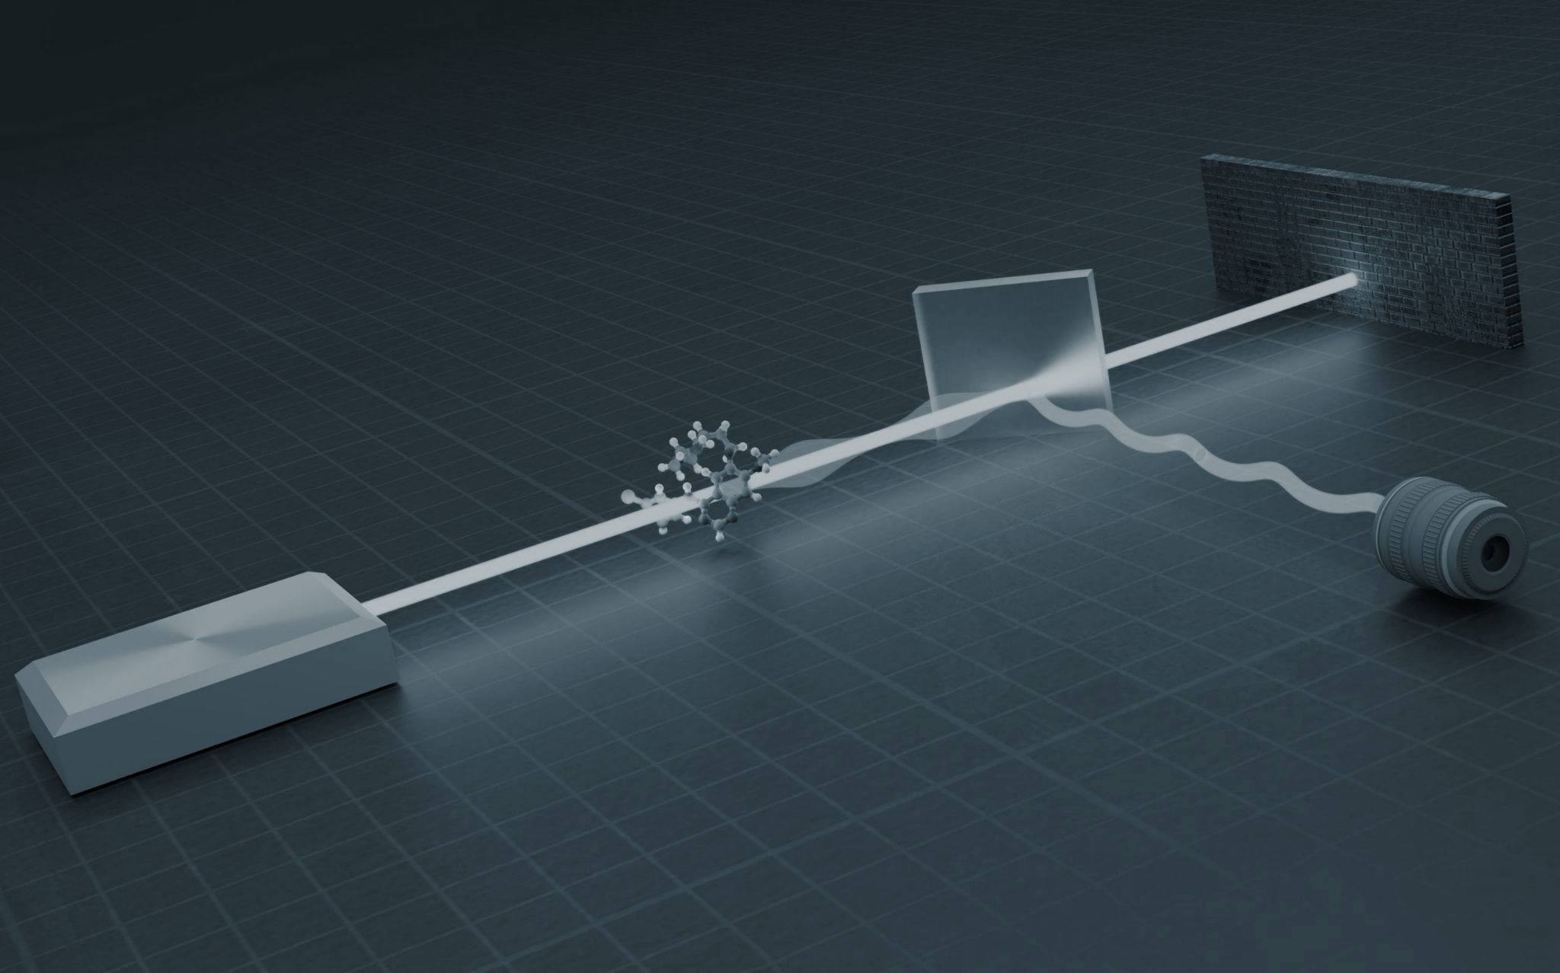


Advances in Quantum Metrology for
Precise Measurements
By Arunava Majumder
arunavaangshuman@gmail.com,
https://www.mdpi.com/1099-4300/23/6/685

Slide 2

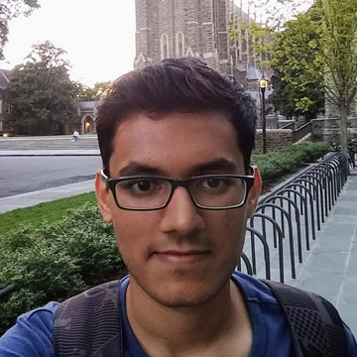

COLLABORATORS
Dr. LEONG CHUAN KWEK
HARSHANK SHROTRIYA

Slide 3
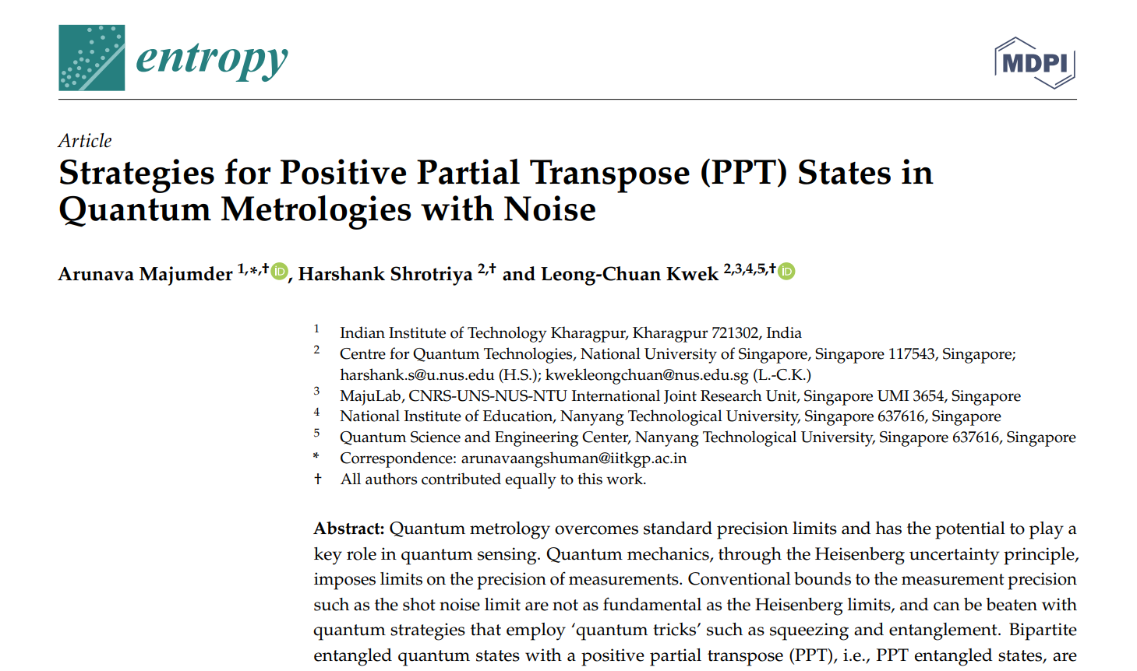
Arunava Majumder (IITKGP) Quantum Metrology September 6, 2021

Slide 4
Arunava Majumder (IITKGP) Quantum Metrology September 6, 2021
OVERVIEW OF THE TALK
Quantum Foundation and information
Quantum Metrology
Noisy Quantum Channels and their effects

Slide 5
Quantum Foundation and information

Slide 6
Bound Entangled or PPT entangled states
Theorem: A higher dimensional PPT
state (i.e. a state that remains positive
under partial transposition) cannot be
distilled (pure entanglement can’t be extracted using distillation protocols).

Slide 7
Arunava Majumder (IITKGP) Quantum Metrology September 6, 2021
PPT ENTANGLED STATES
Bipartite Quantum states
( 2×2 and 2×3)
PPT CRITERIA

Slide 8
Arunava Majumder (IITKGP) Quantum Metrology September 6, 2021
PPT ENTANGLED STATES
Bipartite Quantum states
( 2×2 and 2×3)
PPT CRITERIA
PPT
NPT

Slide 9
Arunava Majumder (IITKGP) Quantum Metrology September 6, 2021
PPT ENTANGLED STATES
Bipartite Quantum states
( 2×2 and 2×3)
PPT CRITERIA
PPT
NPT
SEPARABLE
STATE
ENTANGLED
STATE

Slide 10
Arunava Majumder (IITKGP) Quantum Metrology September 6, 2021
PPT ENTANGLED STATES
Bipartite Quantum states
( 2×2 and 2×3)
PPT CRITERIA
Classical
in nature
PPT
NPT
SEPARABLE
STATE
ENTANGLED
STATE

Slide 11
Arunava Majumder (IITKGP) Quantum Metrology September 6, 2021
PPT ENTANGLED STATES
Bipartite Quantum states
(>2×3 dim. states)
PPT CRITERIA
Not classical in nature
PPT
NPT
OR
ENTANGLED
STATE
SEPARABLE
STATE
ENTANGLED
STATE

Slide 12
Arunava Majumder (IITKGP) Quantum Metrology September 6, 2021
PPT ENTANGLED STATES
Bipartite Quantum states
(>2×3 dim. states)
PPT CRITERIA
Not classical in nature
PPT
NPT
OR
ENTANGLED
STATE
SEPARABLE
STATE
ENTANGLED
STATE

Slide 13
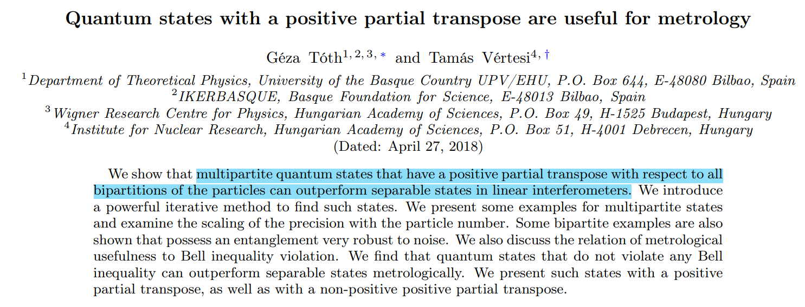
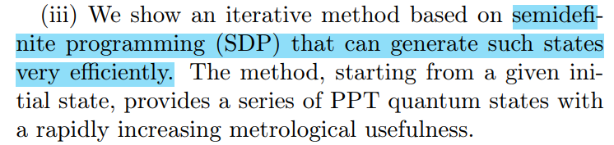
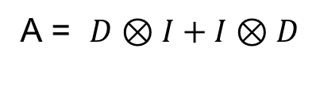
Arunava Majumder (IITKGP) Quantum Metrology September 6, 2021
Why Bound Entangled; Optimal probe state
A = $D⊗I+I⊗D$
https://doi.org/10.1103/PhysRevLett.120.020506

Slide 14
Quantum Metrology

Slide 15
METROLOGY: The science of measurement
A measurement is a physical process which estimates the quantity of a particular observable (or a physical parameter) of a quantum system.
The measurement precision depends on both the performance imperfections and the fundamental limit imposed by the physical laws.

Slide 16
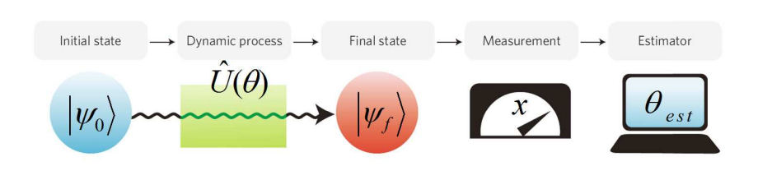
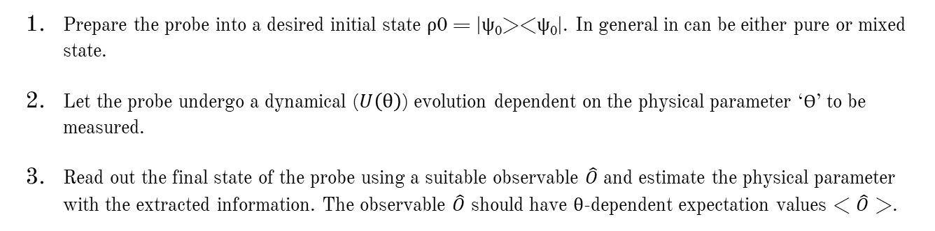
General procedure of Measurements
Arunava Majumder (IITKGP) Quantum Metrology September 6, 2021
Prepare the probe into a desired initial state ρ0 = |ψ₀><ψ₀|. In general in can be either pure or mixed state.
Let the probe undergo a dynamical ($U\left(θ\right)$) evolution dependent on the physical parameter ‘Ɵ’ to be measured.
Read out the final state of the probe using a suitable observable $\hat{O}$ and estimate the physical parameter with the extracted information. The observable $\hat{O}$ should have θ-dependent expectation values < $\hat{O}$ >.
https://doi.org/10.1142/9789814590174_0007

Slide 17
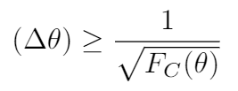
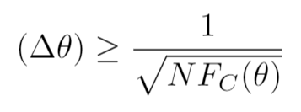
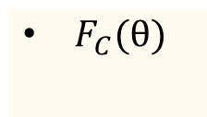
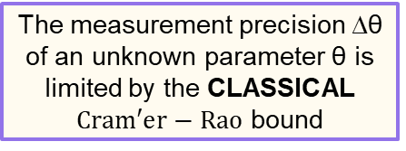
Classical lower bound to Measurements
Arunava Majumder (IITKGP) Quantum Metrology September 6, 2021
We are focusing on single parameter estimation.
After N repetition
The measurement precision ∆θ of an unknown parameter θ is limited by the CLASSICAL $Cram′er−Rao$ bound
$F_{C}(θ)$
CLASSICAL FISHER INFORMATION
https://doi.org/10.1142/9789814590174_0007

Slide 18
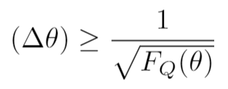
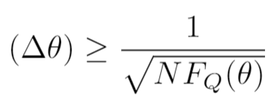
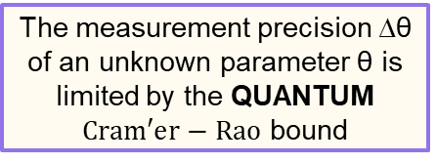
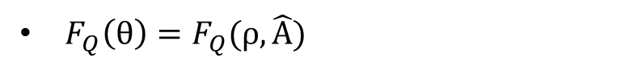
Quantum lower bound to Measurements
Arunava Majumder (IITKGP) Quantum Metrology September 6, 2021
We are focusing on single parameter estimation.
After N repetition
The measurement precision ∆θ of an unknown parameter θ is limited by the QUANTUM $Cram′er−Rao$ bound
$F_{Q}\left(θ\right)=F_{Q}(ρ,\hat{A})$
QUANTUM FISHER INFORMATION
https://doi.org/10.1142/9789814590174_0007

Slide 19
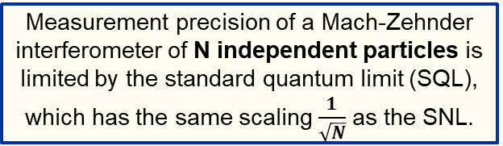
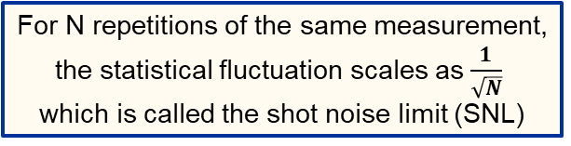
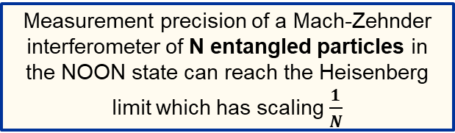
Arunava Majumder (IITKGP) Quantum Metrology September 6, 2021
Limits imposed by Nature
For N repetitions of the same measurement, the statistical fluctuation scales as $\frac{1}{\sqrt{N}}$ which is called the shot noise limit (SNL)
SHOT NOISE LIMIT (SNL)
Measurement precision of a Mach-Zehnder interferometer of N independent particles is limited by the standard quantum limit (SQL), which has the same scaling $\frac{1}{\sqrt{N}}$as the SNL.
STANDARD QUANTUM LIMIT (SQL)
Measurement precision of a Mach-Zehnder interferometer of N entangled particles in the NOON state can reach the Heisenberg limit which has scaling $\frac{1}{N}$
HEISENBERG LIMIT (HL)

Slide 20
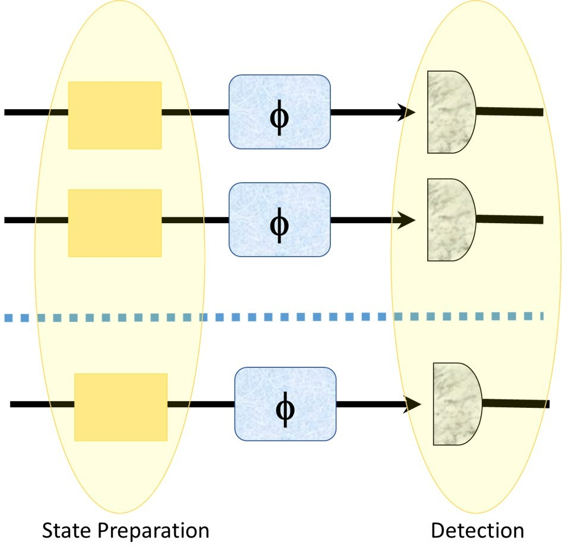
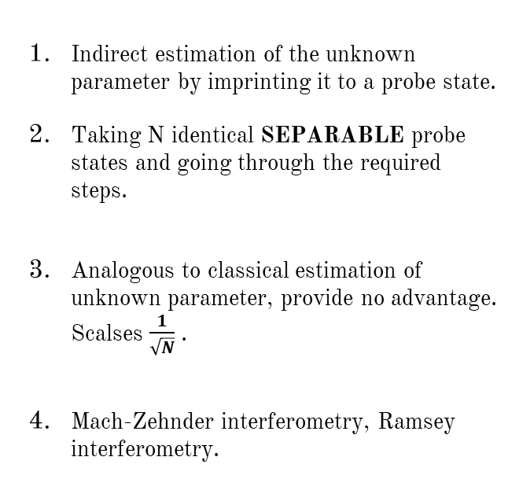
Experimental Realization 1
Arunava Majumder (IITKGP) Quantum Metrology September 6, 2021
Indirect estimation of the unknown parameter by imprinting it to a probe state.
Taking N identical SEPARABLE probe states and going through the required steps.
Analogous to classical estimation of unknown parameter, provide no advantage. Scalses $\frac{1}{\sqrt{N}}$ .
Mach-Zehnder interferometry, Ramsey interferometry.
https://doi.org/10.1142/9789814590174_0007
, https://doi.org/10.3390/e23060685

Slide 21
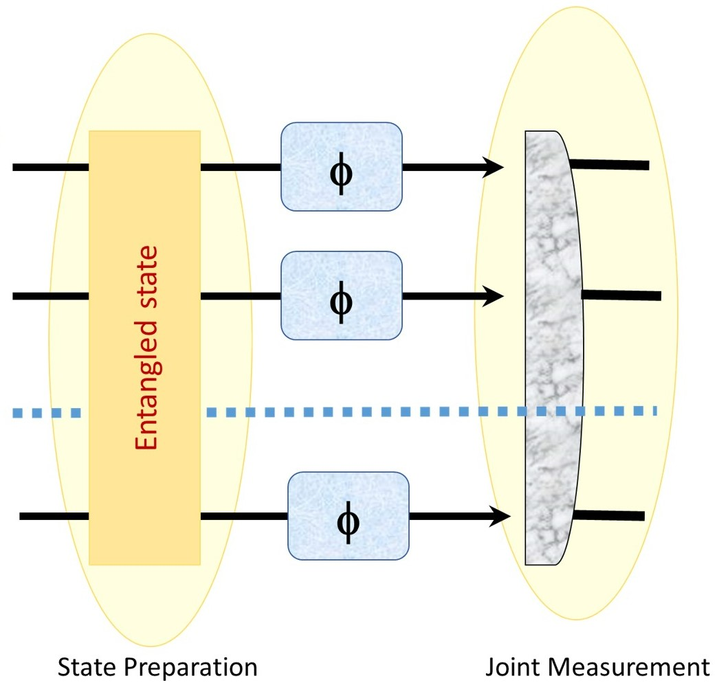
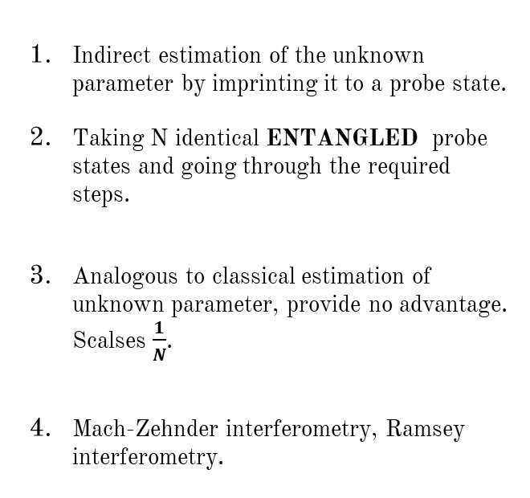
Experimental Realization 2
Arunava Majumder (IITKGP) Quantum Metrology September 6, 2021
Indirect estimation of the unknown parameter by imprinting it to a probe state.
Taking N identical ENTANGLED probe states and going through the required steps.
Analogous to classical estimation of unknown parameter, provide no advantage. Scalses $\frac{1}{N}$.
Mach-Zehnder interferometry, Ramsey interferometry.
https://doi.org/10.1142/9789814590174_0007
, https://doi.org/10.3390/e23060685

Slide 22
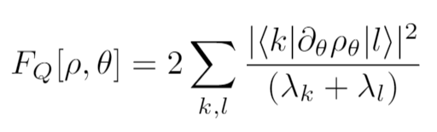
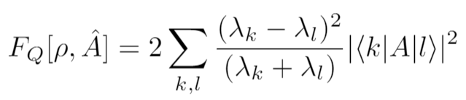
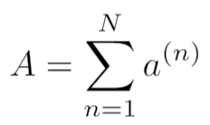
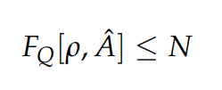
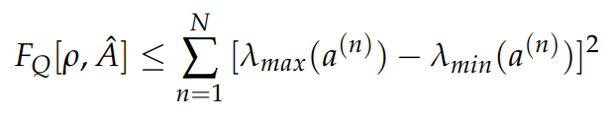
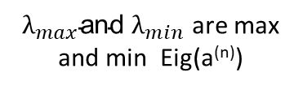
Quantum Fisher Information (QFI)
Arunava Majumder (IITKGP) Quantum Metrology September 6, 2021
We are focusing on single parameter estimation.
The
Encoder
Multi-qubit
separable state
Multi-qudit
separable state
N=Total number of subsystems not particles
${λ_{max}\text{and} λ}_{min}$ are max and min Eig(a^{(n)})
https://doi.org/10.3390/e23060685

Slide 23
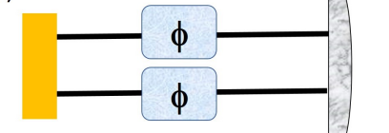


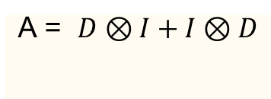
Arunava Majumder (IITKGP) Quantum Metrology September 6, 2021
Parameter encoding schemes
D=Diag[1,1,…,-1,-1]
Further we’ll only consider Bipartite systems of various dimensions
ENTANGLED ASSISTED STRATEGY
ANCILLA ASSISTED STRATEGY
U(θ) =e^{−iAθ}
A = $D⊗I+I⊗D$
A = $D⊗I or I⊗D$
https://doi.org/10.3390/e23060685

Slide 24
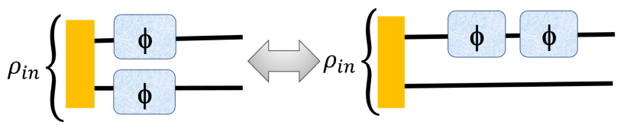

Arunava Majumder (IITKGP) Quantum Metrology September 6, 2021
Adding Sequence to parameter encoding schemes
Considering only Bipartite systems of various dimensions
ENTANGLED
ASSISTED STRATEGY
SEQUENTIAL ANCILLA ASSISTED STRATEGY
U(θ) =e^{−iAθ}
A = $D⊗I+I⊗D$
A = $D⊗I + D⊗I$
https://doi.org/10.3390/e23060685

Slide 25
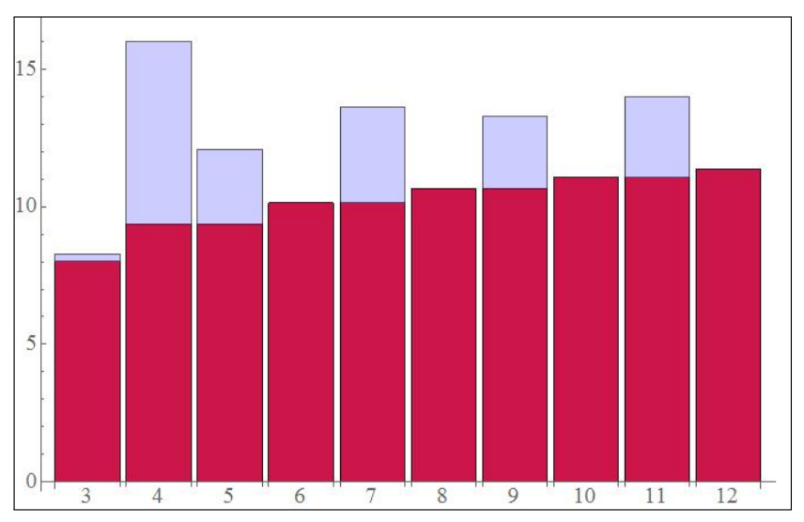
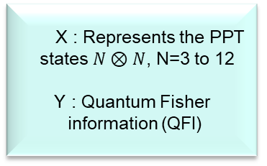
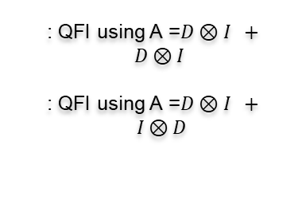
Arunava Majumder (IITKGP) Quantum Metrology September 6, 2021
RESULT 1
X : Represents the PPT
states $N⊗N$, N=3 to 12
Y : Quantum Fisher
information (QFI)
: QFI using A =$D⊗I + D⊗I$
: QFI using A =$D⊗I + I⊗D$
https://doi.org/10.3390/e23060685

Slide 26
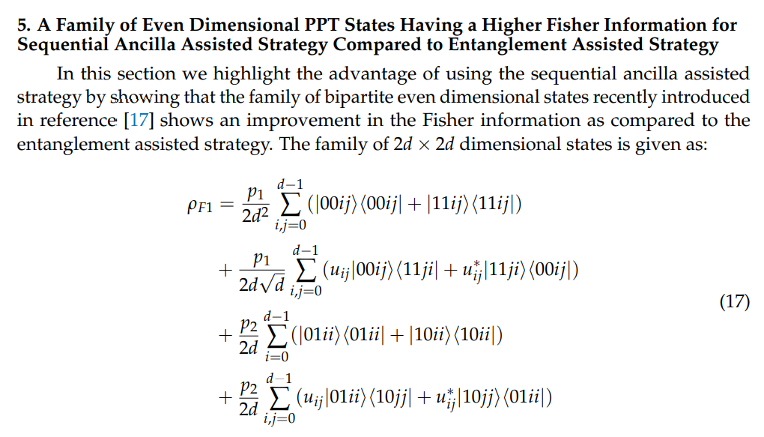
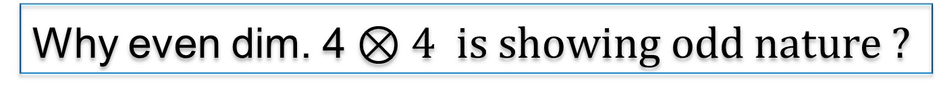
Arunava Majumder (IITKGP) Quantum Metrology September 6, 2021
Why even dim. 4$⊗4 is showing odd nature ?$
The family we are talking about here is different from the family of states found from SDP
https://doi.org/10.1103/PhysRevResearch.3.023101 , https://doi.org/10.3390/e23060685

Slide 27

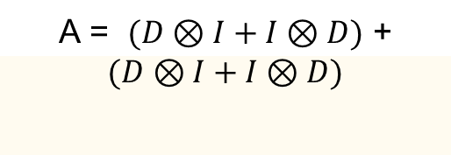
Arunava Majumder (IITKGP) Quantum Metrology September 6, 2021
Parameter encoding schemes with Multiple Sequences
Considering only Bipartite systems of various dimensions
SEQUENTIAL ENTANGLED
ASSISTED STRATEGY
SEQUENTIAL ANCILLA ASSISTED STRATEGY
U(θ) =e^{−iAθ}
A = $\left(D⊗I + D⊗I\right)+$
$(D⊗I + D⊗I$)
A = $(D⊗I+I⊗D)$ +
$$(D⊗I+I⊗D)$$
https://doi.org/10.3390/e23060685

Slide 28
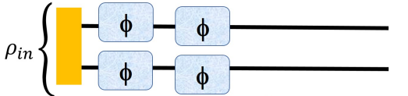
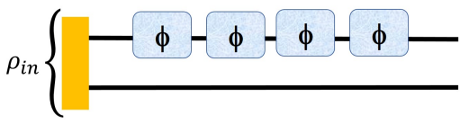
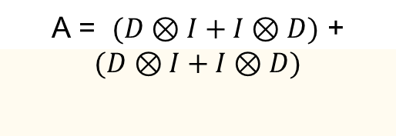
Arunava Majumder (IITKGP) Quantum Metrology September 6, 2021
Parameter encoding schemes with Multiple Sequences
Considering only Bipartite systems of various dimensions
SEQUENTIAL ENTANGLED
ASSISTED STRATEGY
SEQUENTIAL ANCILLA ASSISTED STRATEGY
U(θ) =e^{−iAθ}
A = $\left(D⊗I + D⊗I\right)+$
$(D⊗I + D⊗I$)
A = $(D⊗I+I⊗D)$ +
$$(D⊗I+I⊗D)$$
https://doi.org/10.3390/e23060685

Slide 29
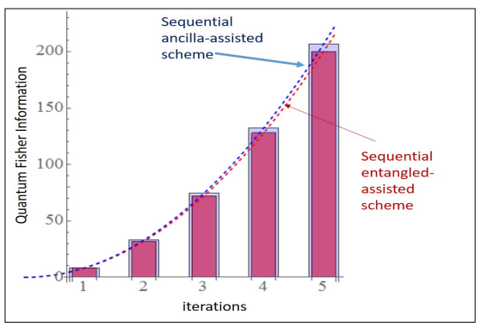
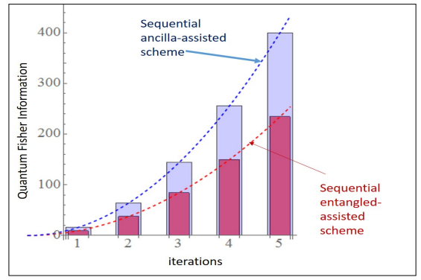
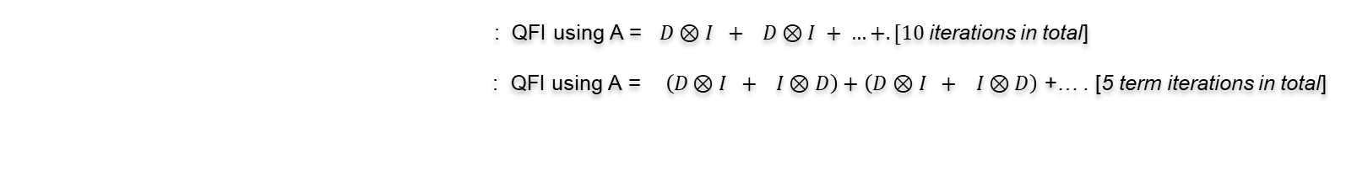
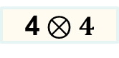
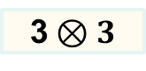
Arunava Majumder (IITKGP) Quantum Metrology September 6, 2021
RESULT 2
3$⊗3$
4$⊗4$
: QFI using A = $D⊗I + D⊗I + …+. [10$iterations in total]
: QFI using A =$\left(D⊗I + I⊗D\right)+$ $\left(D⊗I + I⊗D\right)$ +… . [5 term iterations in total]
https://doi.org/10.3390/e23060685

Slide 30
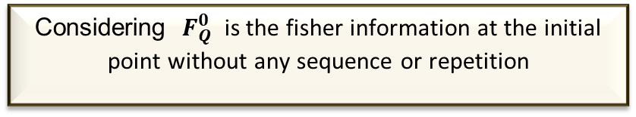
Arunava Majumder (IITKGP) Quantum Metrology September 6, 2021
Advantage of having sequences
Considering ${ F}_{Q}^{0}$ is the fisher information at the initial point without any sequence or repetition
https://doi.org/10.3390/e23060685

Slide 31
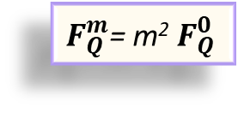
Arunava Majumder (IITKGP) Quantum Metrology September 6, 2021
Advantage of having sequences
Considering ${ F}_{Q}^{0}$ is the fisher information at the initial point without any sequence or repetition
After “m” sequences regardless of ENT or ANC assisted strategy
$F_{Q}^{m}$= m²${ F}_{Q}^{0}$
https://doi.org/10.3390/e23060685

Slide 32
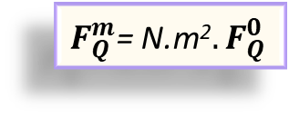
Arunava Majumder (IITKGP) Quantum Metrology September 6, 2021
Advantage of having sequences
Considering ${ F}_{Q}^{0}$ is the fisher information at the initial point without any sequence or repetition
After “m” sequences regardless of ENT or ANC assisted strategy
$F_{Q}^{m}$= m²${ F}_{Q}^{0}$
After “N” repetitions regardless of ENT or ANC assisted strategy
$F_{Q}^{m}$= N.m²${. F}_{Q}^{0}$
https://doi.org/10.3390/e23060685

Slide 33
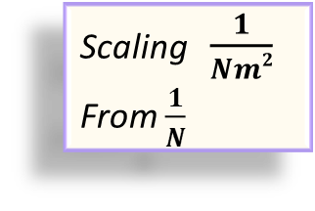
Arunava Majumder (IITKGP) Quantum Metrology September 6, 2021
Advantage of having sequences
Considering ${ F}_{Q}^{0}$ is the fisher information at the initial point without any sequence or repetition
After “m” sequences regardless of ENT or ANC assisted strategy
$F_{Q}^{m}$= m²${ F}_{Q}^{0}$
After “N” repetitions regardless of ENT or ANC assisted strategy
Scaling $\frac{1}{Nm2}$
From $\frac{1}{N}$
$F_{Q}^{m}$= N.m²${. F}_{Q}^{0}$
https://doi.org/10.3390/e23060685

Slide 34

Arunava Majumder (IITKGP) Quantum Metrology September 6, 2021
Advantage of having sequences
Considering ${ F}_{Q}^{0}$ is the fisher information at the initial point without any sequence or repetition
After “m” sequences regardless of ENT or ANC assisted strategy
At N=m, scaling $\frac{1}{N3}$
$F_{Q}^{m}$= m²${ F}_{Q}^{0}$
After “N” repetitions regardless of ENT or ANC assisted strategy
Scaling $\frac{1}{Nm2}$
From $\frac{1}{N}$
$F_{Q}^{m}$= N.m²${. F}_{Q}^{0}$
https://doi.org/10.3390/e23060685

Slide 35
Applications
Arunava Majumder (IITKGP) Quantum Metrology September 6, 2021
Magnetometry: Magnetometry allows one to measure the magnetic field precisely by measuring the phase shift of the particles due to magnetic field(as particles are waves). If the particles are entangled, precision of this measurement will improve Quantum enhanced magnetometry
LIGO Gravitational wave detection: To improve the sensitivity of laser light, it is prepared in squeezed state which is less sensitive to noise. Thus can perform precise measurement of the periodic distortion of space and time.
Thermometry ..........

Slide 36
Noisy Quantum Channels and their effects

Slide 37
Arunava Majumder (IITKGP) Quantum Metrology September 6, 2021
Quantum Noise
Noise
COHERENT
INCOHERENT
Due to interaction of physical system with noisy environment.
Doesn’t maintain quantum coherence
Example: Depolarizing channel……...
Due to miscalibrations, crosstalk in hardware / experimental setup.
Maintains coherence, results in an under or over rotation
https://doi.org/10.3390/e23060685

Slide 38


Arunava Majumder (IITKGP) Quantum Metrology September 6, 2021
Incoherent Quantum Noise
Noisy channel /
CPTP map
Depolarizing Noisy channel
Asymmetric
Symmetric
https://doi.org/10.3390/e23060685

Slide 39





Arunava Majumder (IITKGP) Quantum Metrology September 6, 2021
Results including noise
A = $(D⊗I+I⊗D)$ +
$(D⊗I+I⊗D)$ +….
3$⊗3$ and 4$⊗4$
respectively
For a total 3 sequences
11$⊗11$ and 12$⊗12$
respectively
https://doi.org/10.3390/e23060685

Slide 40
THANK YOU SO MUCH!

